Slide 1
University of Diyala College of Engineering Dept. of Communications

Slide 2
“ Digital Communications “ By Haidar N. Al-Anbagi Lec (4) Time: (4 hrs) 2017

Slide 3
Pulse Code Modulation (PCM)
It is an analog to digital conversion method by which the information contained in the instantaneous samples of the analog signals is represented by digital words in a serial bit stream. Assuming that the number of binary digits is n, then the number of possible unique code words is $M=2^{n}$. For example, if we have three binary digits, we would have 8 possible code words to represent all amplitude levels.

Slide 4
PCM is so popular because of the unique aspects it provides. Some of the advantages of PCM are listed below:
Relatively inexpensive digital circuits can be used to build the system.
Time division multiplexing (TDM) can be used to time division multiplex the digital signals with PCM signals (originally are audio or video signals).
When transmitting for long distances, like long-distance digital telephone systems, repeaters are required to regenerate the signal. In case of PCM signal, the repeater can regenerate the noisy PCM to produce a clean PCM signal; however, we may still get errors because of noise.
The noise performance of digital systems is better than the noise performance of analog systems. Moreover, errors and noise effects in digital systems can be reduced even more using proper coding techniques.

Slide 5
Question: What is the only disadvantage of PC?

Slide 6
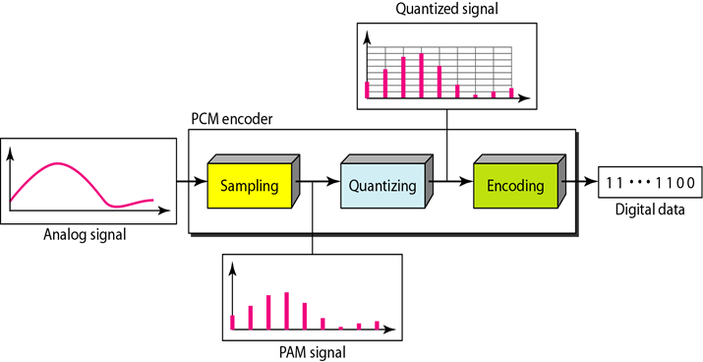
Generation of PCM
The generation of PCM signal involves three main steps which are clearly shown in figure 4.
Figure 4 shows the generation of PCM signal

Slide 7
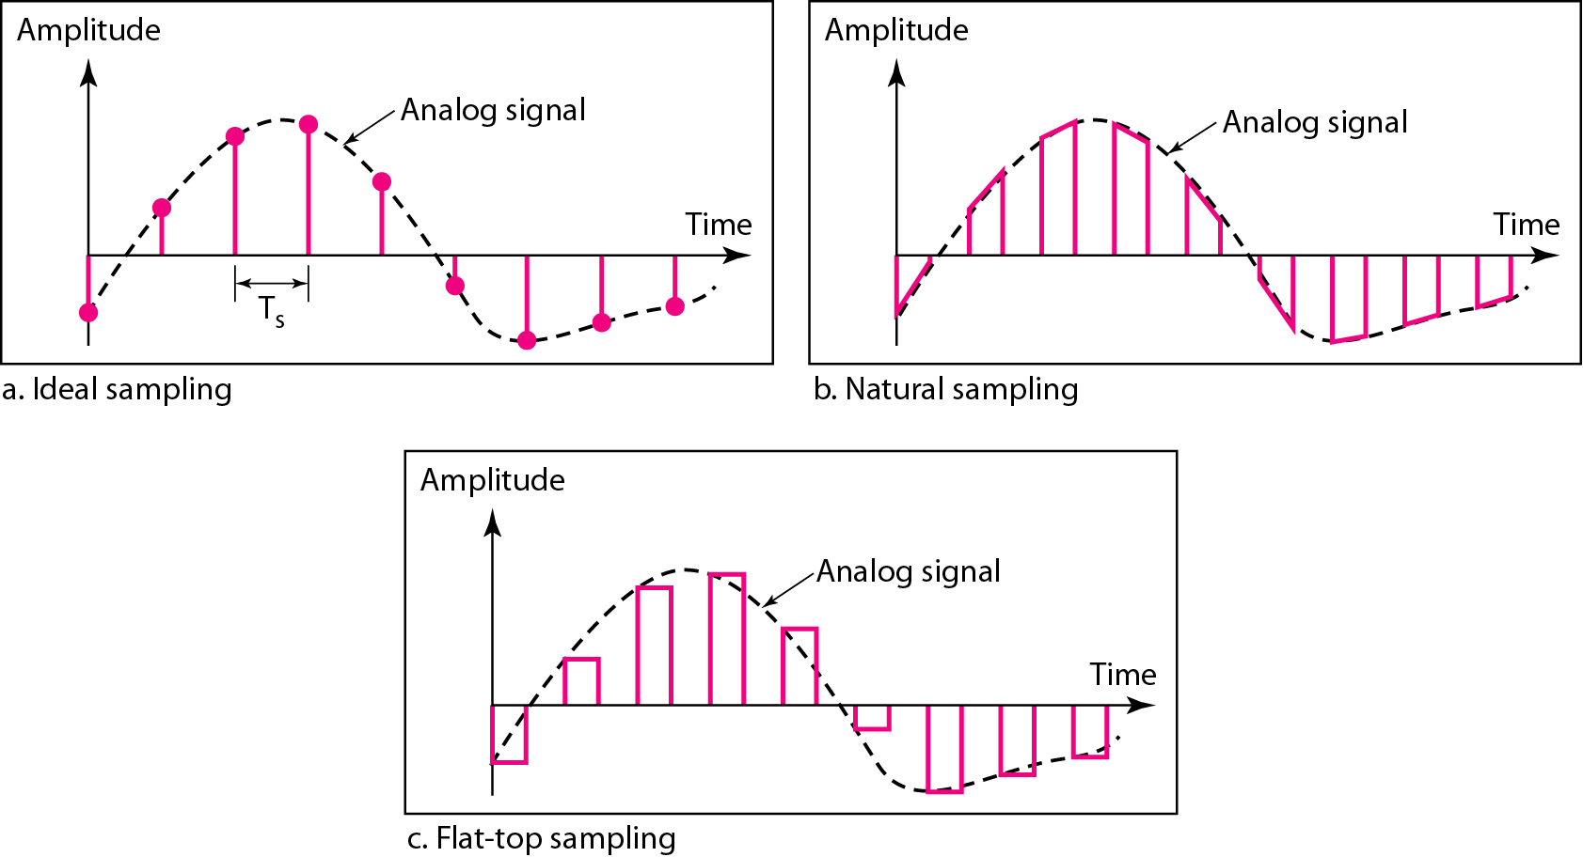
1. Sampling
Three different sampling methods can be implemented as it is shown in figure 5.
Figure 5 shows the three possible sampling methods can be used in PCM

Slide 8
Sampling theorem:
NOTE: We should keep in mind that the sampling rate must be at least 2 times compared to the highest frequency contained in the signal (Nyquist theorem).
Question: What will happen when we do sampling with a rate of:
$f_{s}$= ${2f}_{m}$ 2. $f_{s}$= ${4f}_{m}$ 3. $f_{s}$= ${0.5f}_{m}$
Solution: As we see in figure (6):
Sampling at a rate of $f_{s}$= ${2f}_{m}$ generates good estimate of the original signal.
Sampling at a rate of $f_{s}$= ${4f}_{m}$ generates good estimate of the original signal, however, with redundant unnecessary samples (over sampling).
Sampling at a rate of $f_{s}$= ${0.5f}_{m}$ generates a sampled signal which does not look like the same as the original signal was (under sampling)

Slide 9
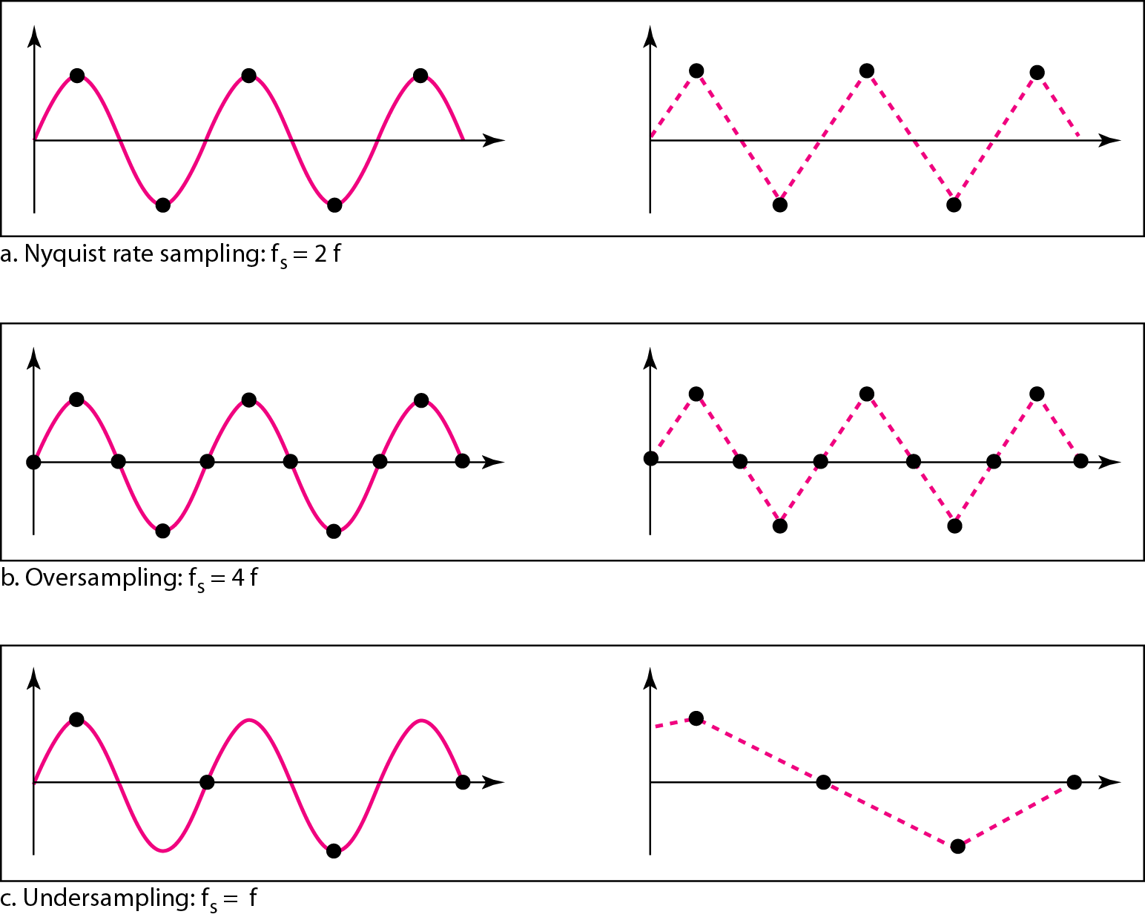
Figure 6 shows how sampling rate affects on the sampled signal

Slide 10
Question: Based on Nyquist theorem, what is the sampling rate the telephone companies should use to sample and digitize voice? ($f_{m}=4000 Hz$)

